Slide 1


Slide 2
Index
Podium on the Dominion Financial Wholesale Website – Page 4
Podium Login – Pages 5-6
Welcome Page – Page 7
Register/Add New Loan – Pages 8-12
Loan Tracker – Page 13
Loan Application – Page 14
Broker Fees – Page 15
Import Broker Credit Report – Page 16
Product and Pricing – Pages 17-22
Upload Loan Submission Documents – Pages 23-24
Conditional Loan Approval – Page 25

Slide 3
Index - Continued
Conditions & Resubmission – Page 26-29
Data Entry – Page 31
Credit – Dominion – Pages 32-33
LOI or GFE – Pages 34-39
Appraisal Links – Page 40
Pipeline – Page 41
Administrator – Pages 43-44

Slide 4

PODIUM on the Dominion Wholesale Website
Visit dominionfinancialwholesale.com to access the Podium platform
https://podium.dominionfinancialwholesale.com

Slide 5
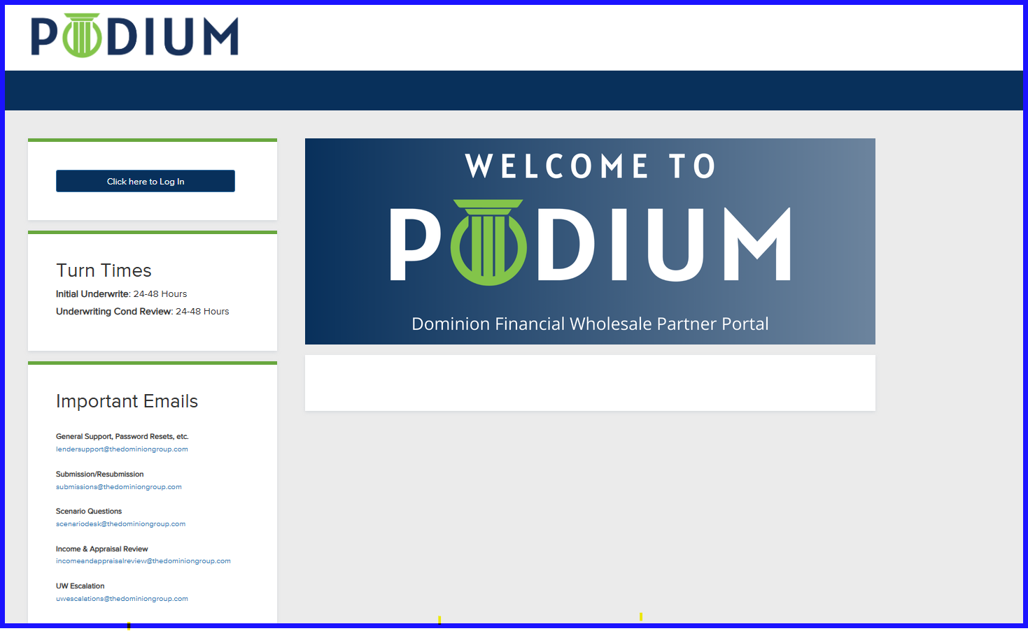
Podium Login Page

Slide 6
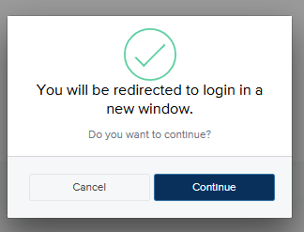
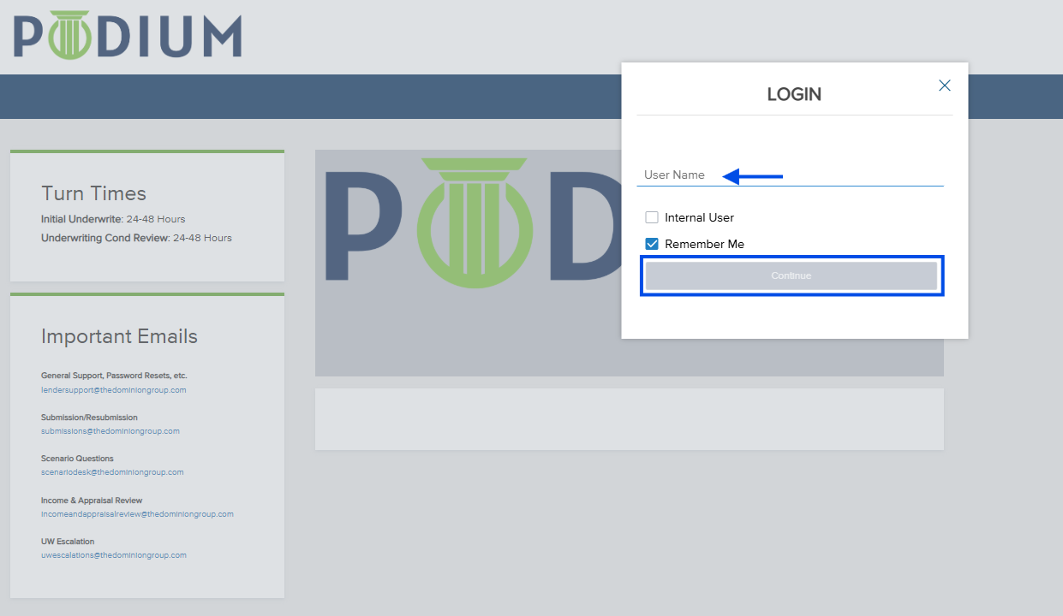
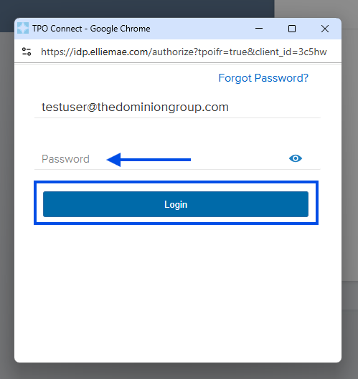
Login Page Continued
Enter PODIUM User Name (do not check internal user), select continue
Press continue to the second box
A separate window will open, to input password, then Click Login

Slide 7
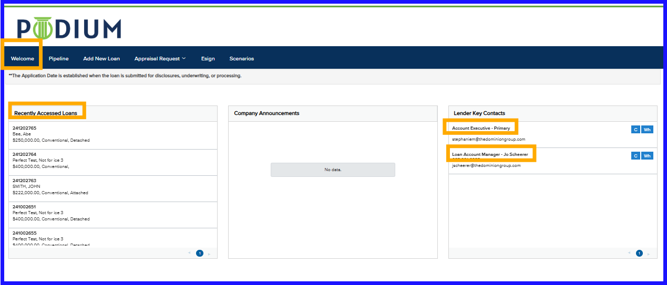
Welcome Page
Lender Key Contacts – Assigned AE and LAM contact information
Recently Accessed Loans – Last 5 loans accessed

Slide 8
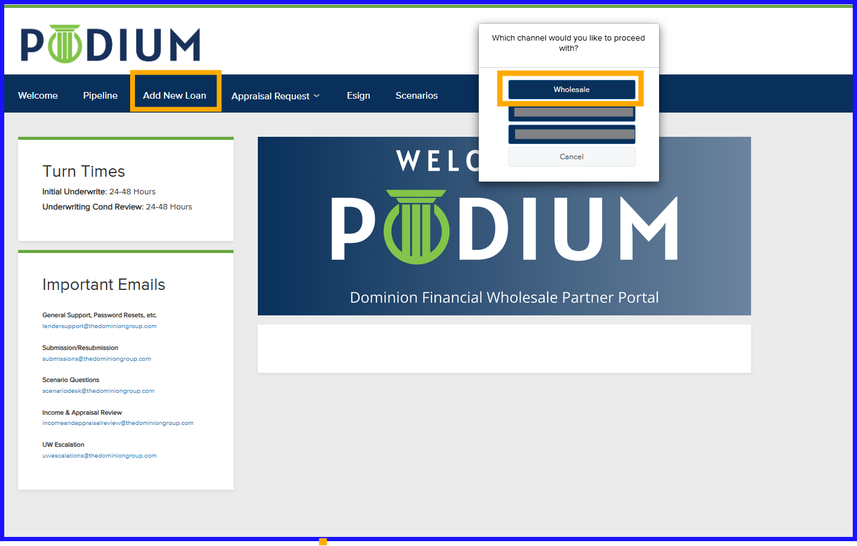
Register/Add New Loan
Click on Add New Loan
Click on Wholesale

Slide 9
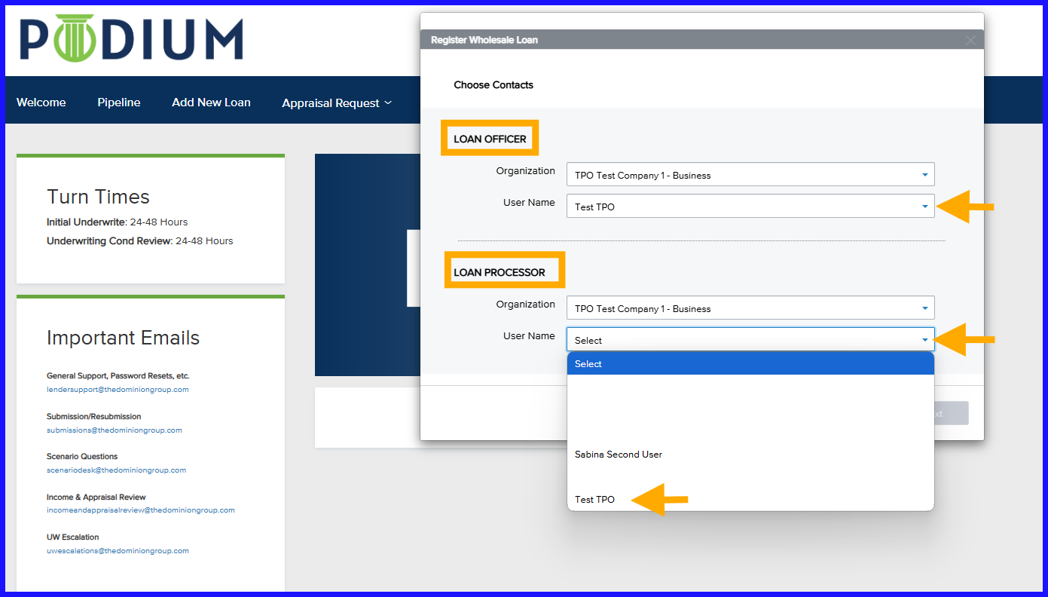
Register/Add New Loan
Enter Loan Officer and Loan Processor names; If no processor, add LO to both contact boxes
Select NEXT
Contacts will receive all notifications on loan
If name is not an option in the drop down, contact your company Admin or AE for assistance
Notes:
Your Organization will populate. Enter the Loan Officer name from the drop down in the top section for Loan Officer. Enter the Loan Processor name from the drop down in the Loan Processor section, and if there is not Loan Processor, select the Loan Officer name again here. Select NEXT. The contacts entered here will receive all notifications on the loan. If your name is not in the drop down please reach out to your company Admin who will have the ability to add LO’s and LP’s to the company account so you show in the drop down.

Slide 10
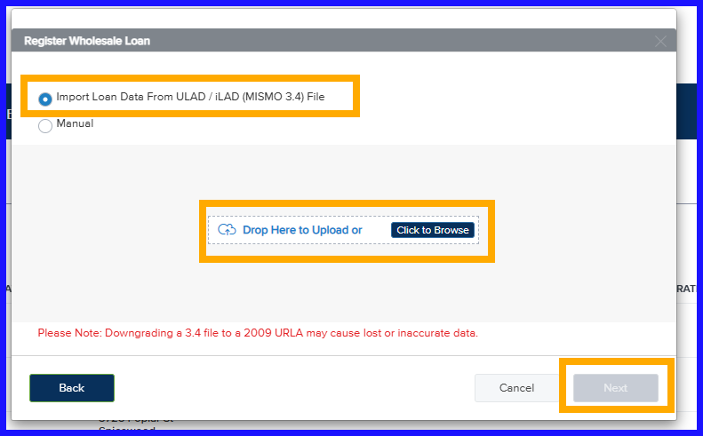
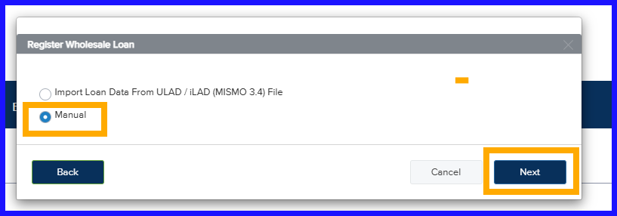
Manual Entry or MISMO 3.4 Upload
Import a 3.4 MISMO file or select Manual for data to be entered manually
Notes:
You have the option to upload your 3.4 MISMO file here, or select manual entry.

Slide 11
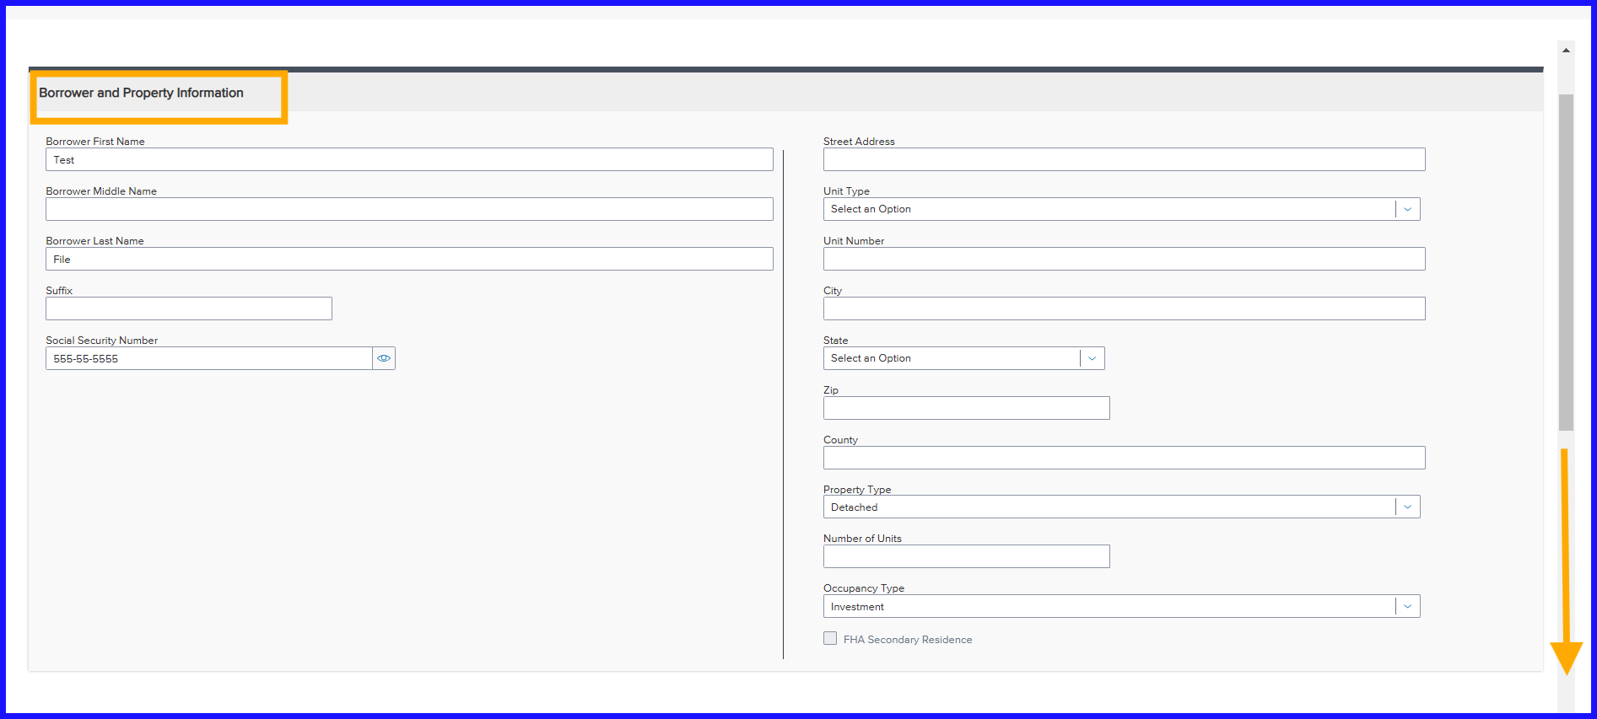
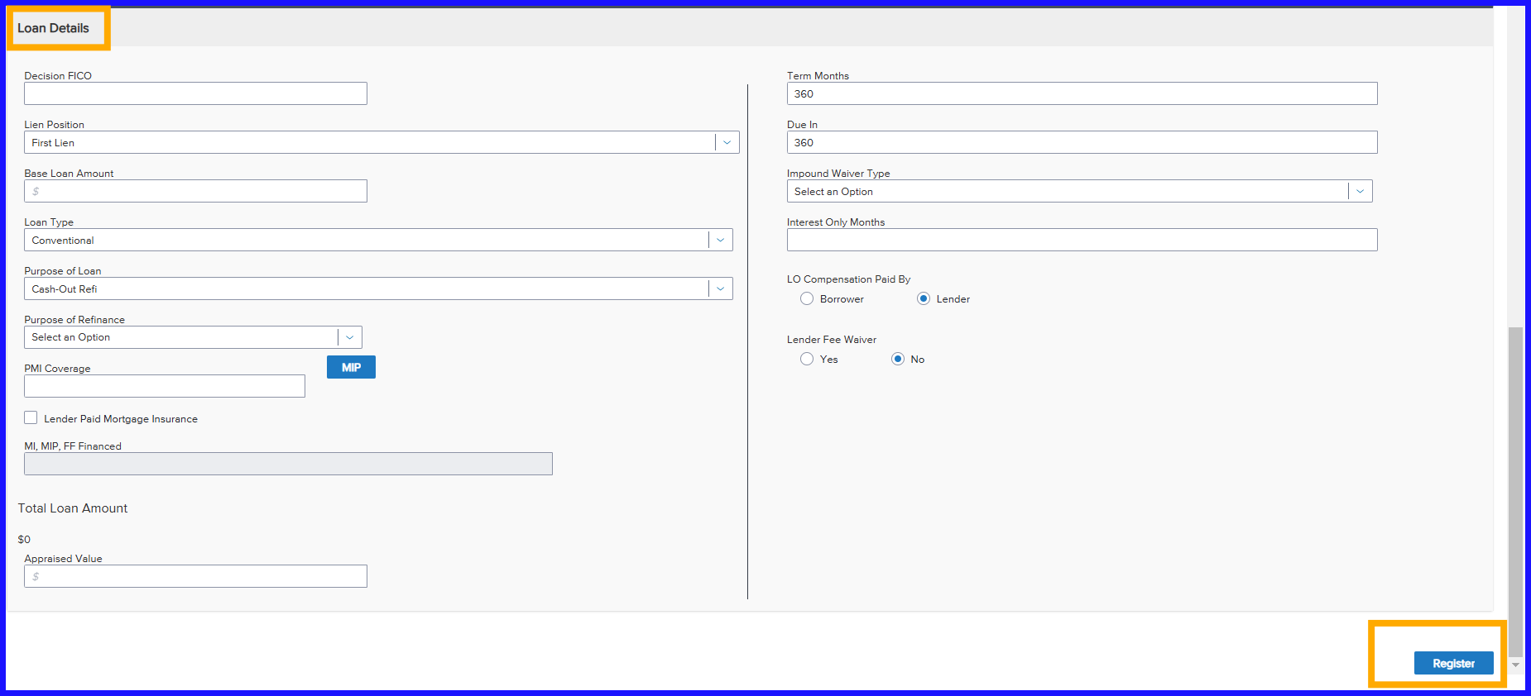
Quick Register – Manual Entry
Mismo 3.4 upload will complete most of these fields
For manual entry input the fields on the Quick Register screens.
Click the Register box at the bottom of the 2nd screen once completed.
Notes:
If you uploaded a 3.4 MISMO file then most of the fields will be completed on the Quick Register screens. If you chose manual entry, you would complete these two screens. Click on the Register box to complete the step.

Slide 12
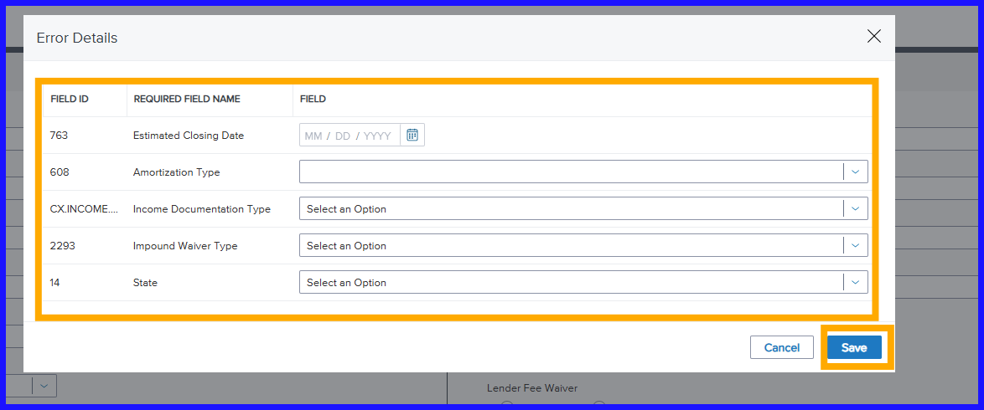
Required Fields
Required information needed will display in a pop-up box to enter
Notes:
Information that is required will show in a pop-up box for you to enter. The fields that pop up will be driven by the information you have provided so far, either in the MISMO 3.4 file, or in your manual entry.

Slide 13
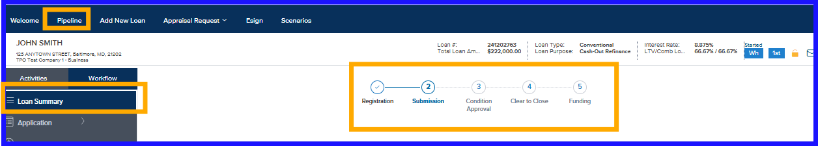
Loan Tracker
Loan Tracker displayed at top of Loan Summary page in loan
At stage completion, the number updates to a check mark
Notes:
The Loan Tracker is displayed along the top of the page and remains visible as you move through the page options. As each stage is completed the number will be replaced with a check mark. This is a great way to quickly see your loan status.

Slide 14
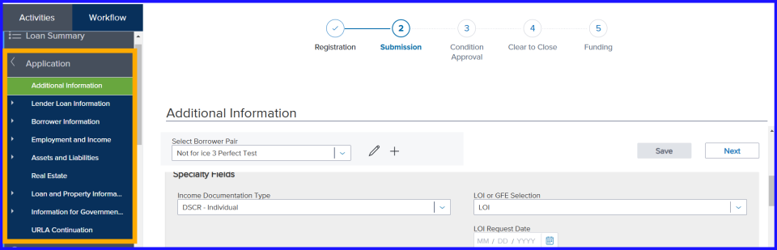
Loan Application
Application – add, edit, delete data
Next button – move to each page without losing data entered
Save button –saves data
When prompted - Save information to the loan file

Slide 15
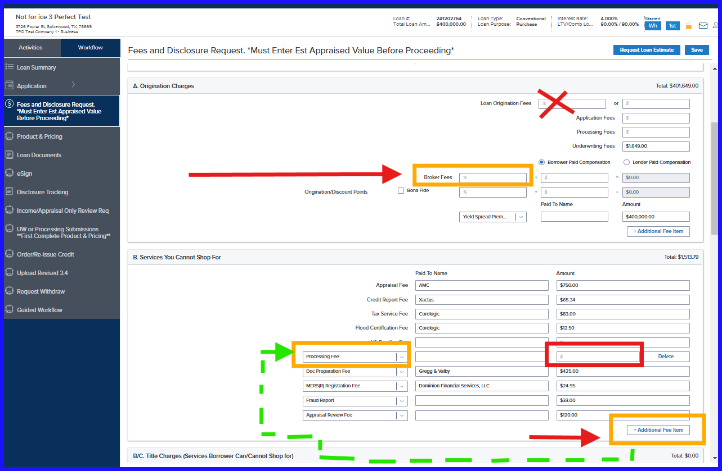
Input Broker Fees
Non TRID Loans: Business Purpose (Investment Property)
Enter Broker Fee in Broker Fees box
For Processing Fee
  Select additional fee box
  Use drop down and select Processing Fee
  Enter fee amount
Notes:
Enter your Broker Fee in the box that says Broker Fees. For your Processing Fee select additional fee box, then use the drop down to select Processing Fee, and enter the fee amount.

Slide 16
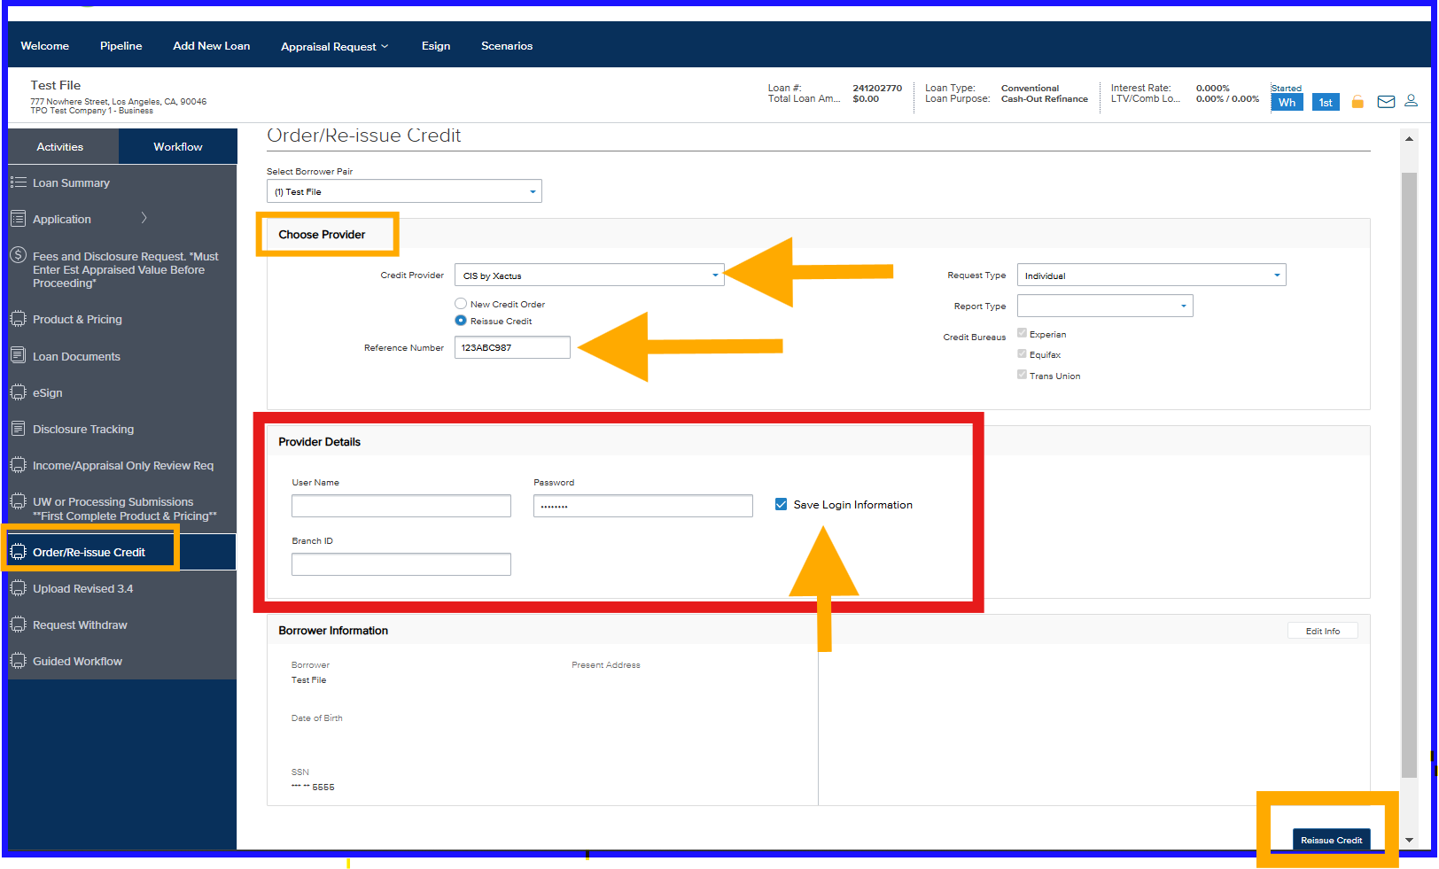
Credit – Importing Broker Credit
Select credit provider from drop down
Select Reissue Credit
Enter the credit report reference number
Enter your credentials for your credit vendor.
Click "Save Login Information" box
Select the Reissue Credit box.
Select at prompt "only liabilities with balances"
Notes:
Select credit provider in the drop down. Select Reissue Credit. Enter the credit report reference number that you are importing. Enter your credentials for your credit vendor. We do not have access to your credentials or what your credit vendor requires for you to input in the Provider Details. If you want to save your credentials you can check the Save Login Information box. Select the Reissue Credit box. The system will ask you if you want to import all liabilities or only liabilities with balances.

Slide 17

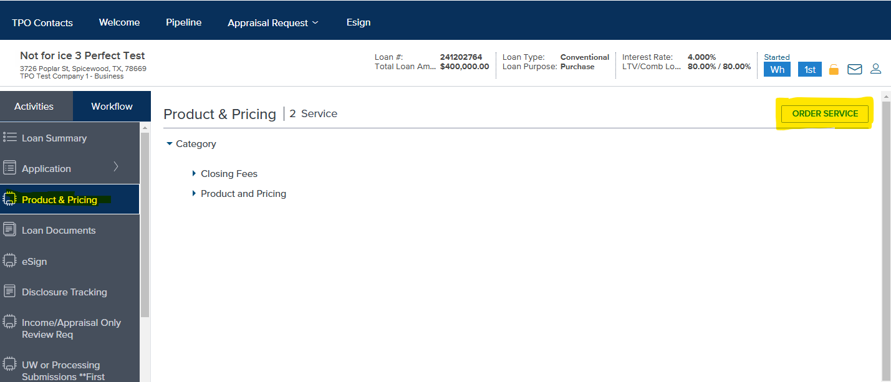
Product and Pricing
2nd
1st

Slide 18
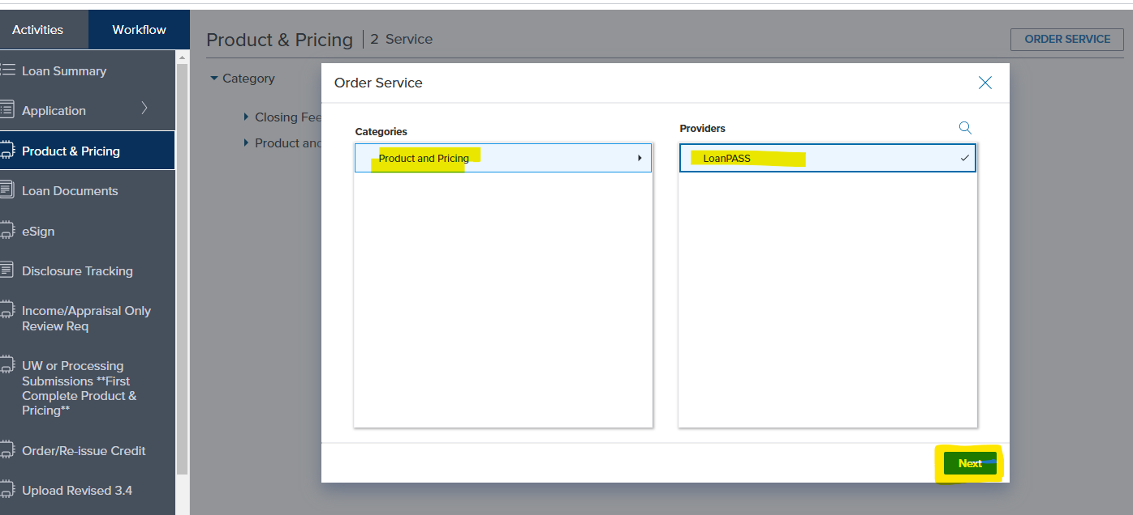
Product and Pricing

Slide 19
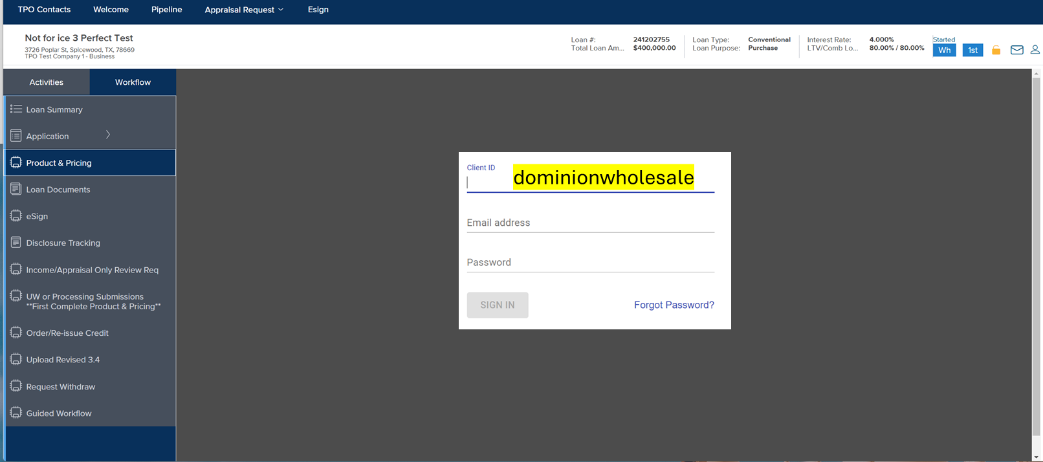
LoanPass Login
LoanPass Login
Client ID: dominionwholesale
Email Address: User Specific
Password: User Specific
Credentials – only need to be entered first time

Slide 20
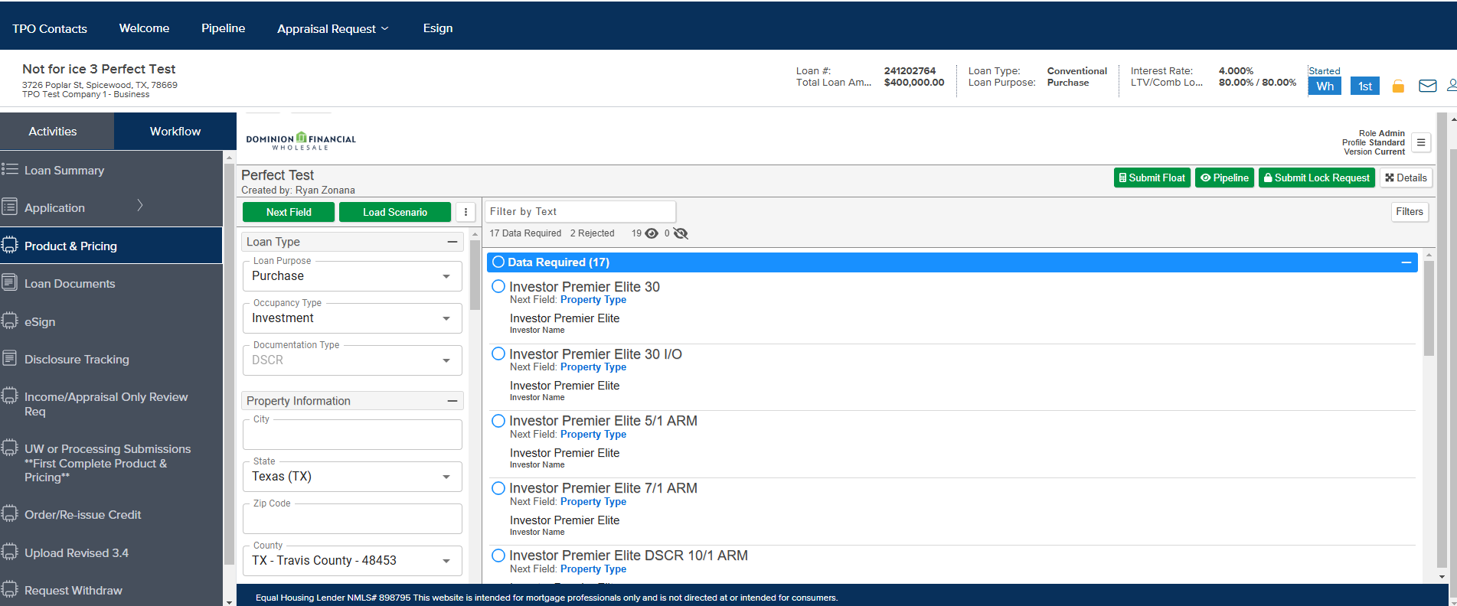
Finalize Product and Pricing Inputs
Complete any remaining required fields to receive eligible product and pricing results.

Slide 21
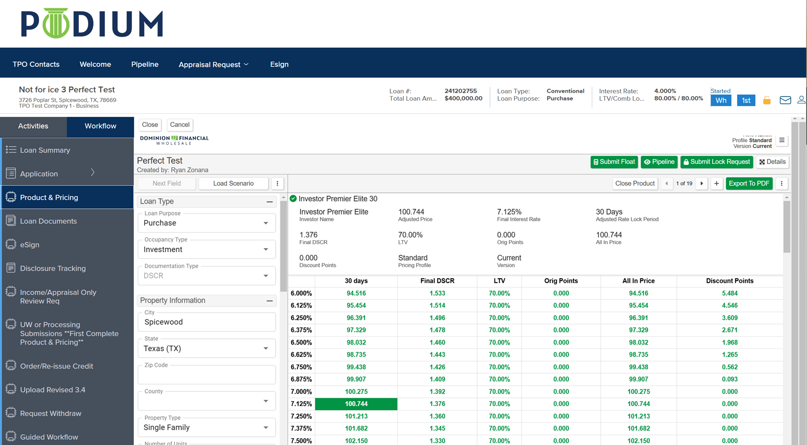

Submit Float or Submit Lock Request
Select desired eligible Product and Rate
Choose “Submit Float” or “Submit Lock Request”

Slide 22
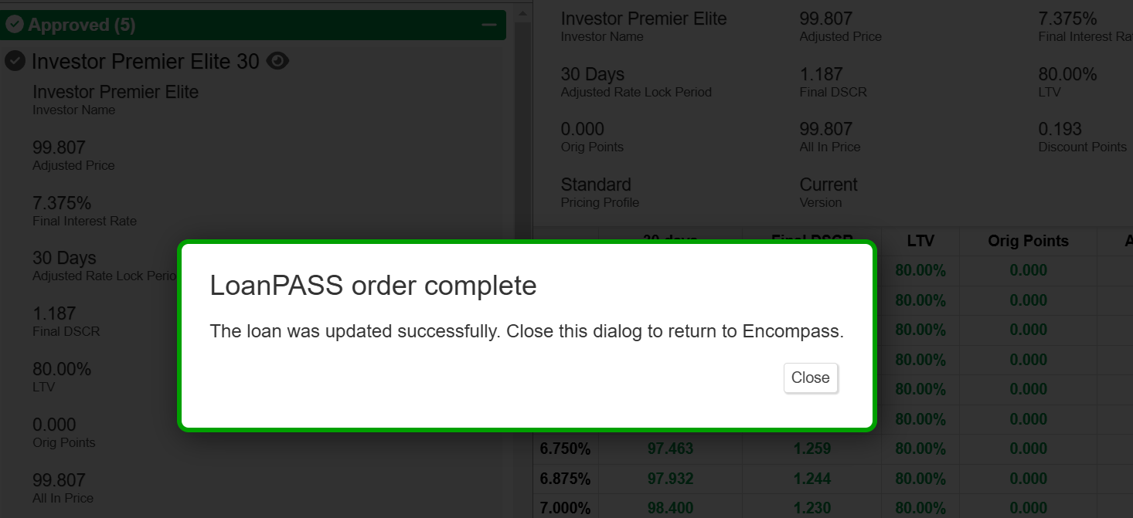
Product and Pricing Order Complete
Float or Lock Request - LoanPASS print out populates to "Product and Pricing" folder under the "Loan Documents" tab

Slide 23
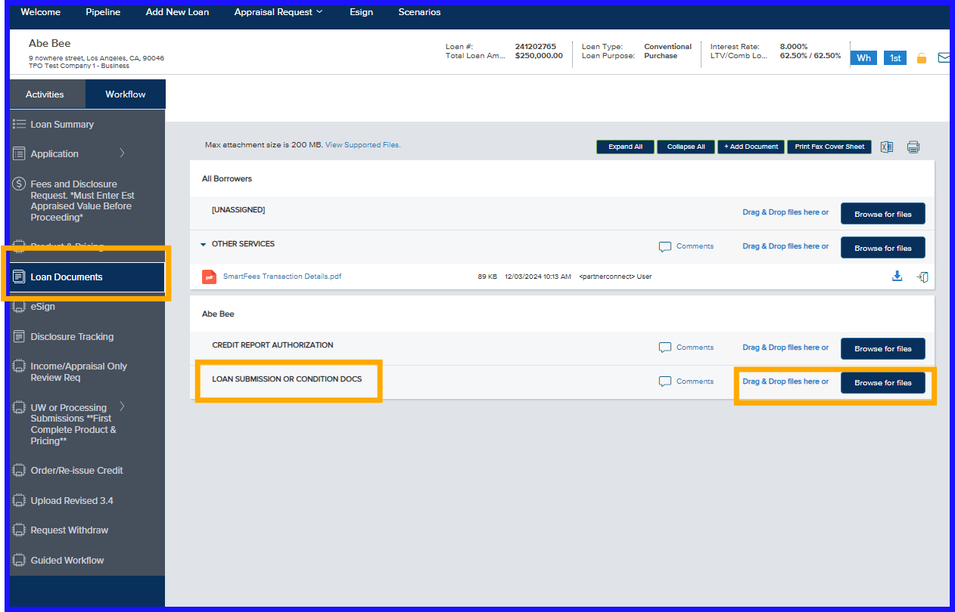
Upload Loan Submission Documents
Upload all Submission Documents into the “Loan Submission or Conditions Docs bucket”
Upload all Condition Document into the same bucket
Do not upload your conditions or submission to individual buckets
Notes:
Upload all Submission Documents into the Loan Submission or Conditions Docs bucket

Slide 24
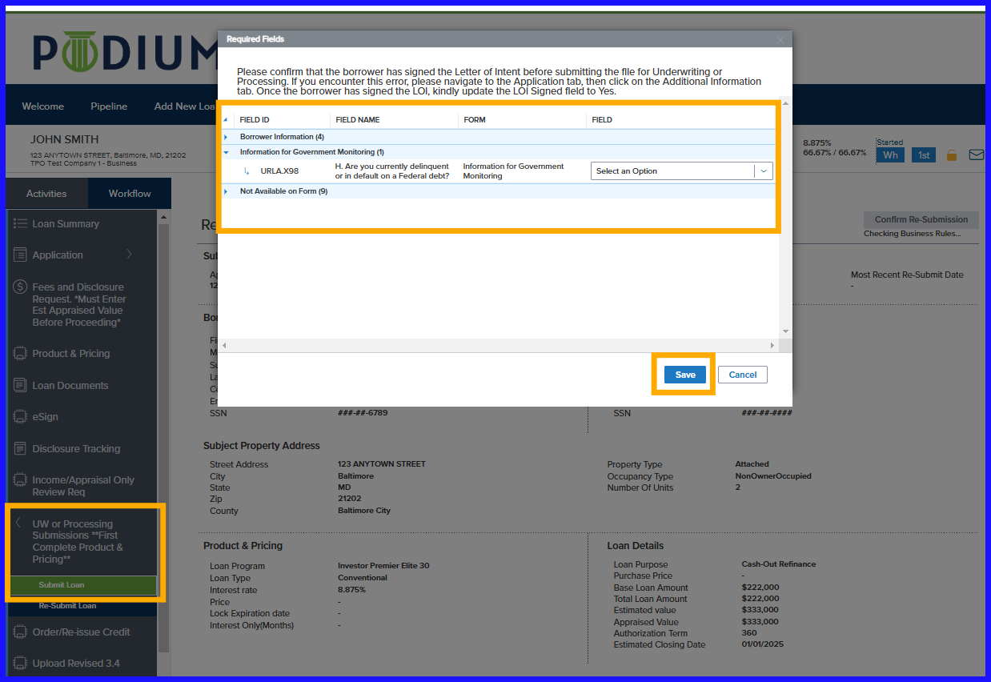
Loan Submission
Select the Submit Loan option
Required fields missing before loan submission will be highlighted
Input missing data and select Save.
S
A
V
E
SUBMIT LOAN
Notes:
Any additional fields will pop up that need to be completed prior to submitting the loan, including one to confirm date LOI was signed. Complete all fields that pop up and select SAVE. The file will show a submitted message once the submission is complete.

Slide 25
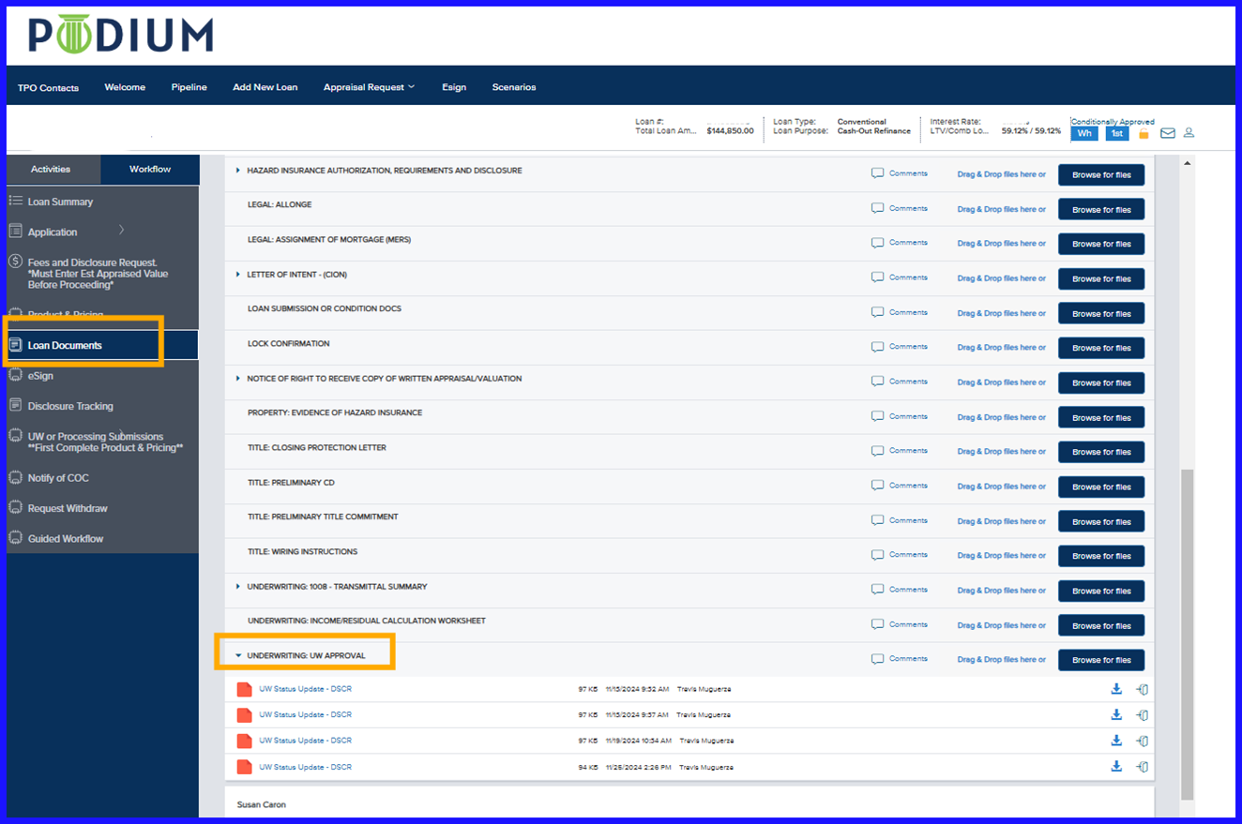
Conditional Loan Approvals
Conditional and Final Loan Approvals will appear in the "UW Approval" bucket in "Loan Documents"
Approval emailed after Underwriter review

Slide 26
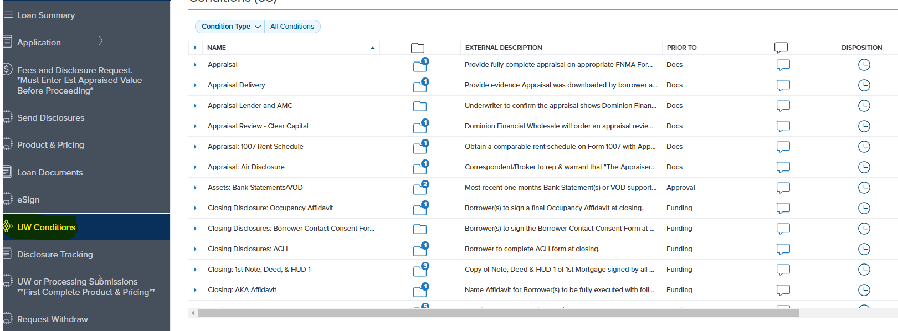
Upload Conditions & Resubmission
Click on UW Conditions tab to view conditions

Slide 27
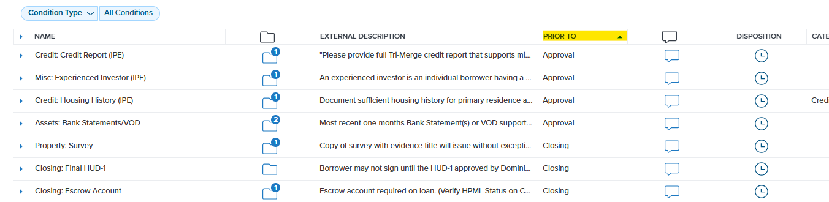
Upload Conditions & Resubmission
Search condition by "Prior To" statuses: Approval, Docs, Closing and Funding
For CTC, all approval and doc conditions must be cleared

Slide 28
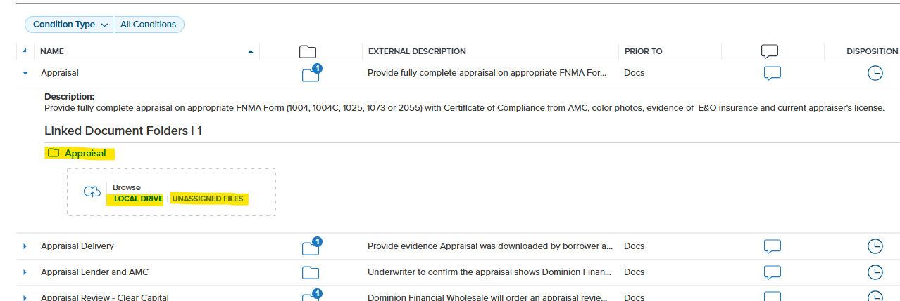
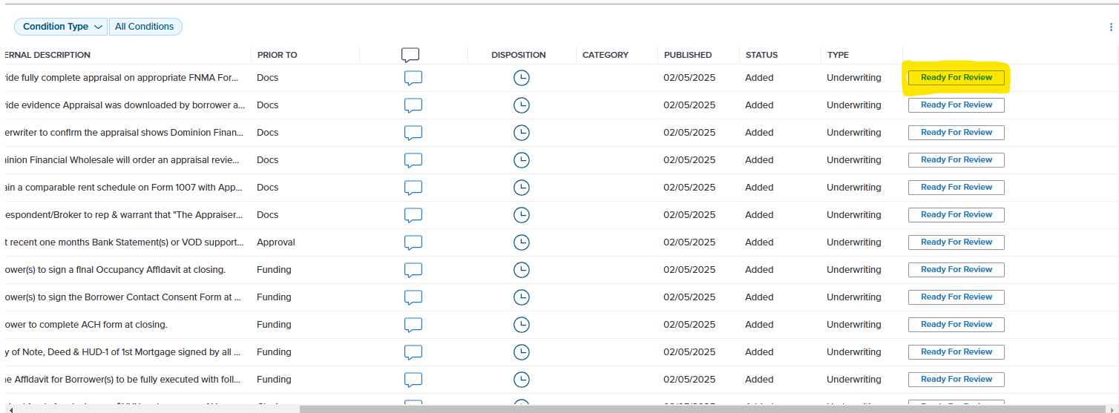
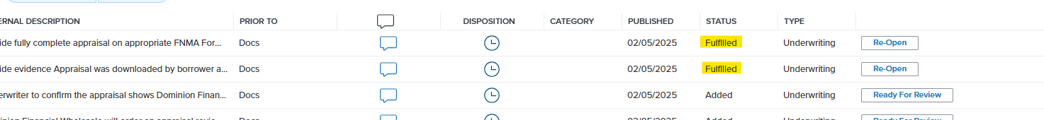
Upload Conditions & Resubmission
#1 Upload document to Condition
#2 Click on Ready For Review
#3 After completing #2, status changes to Fulfilled

Slide 29
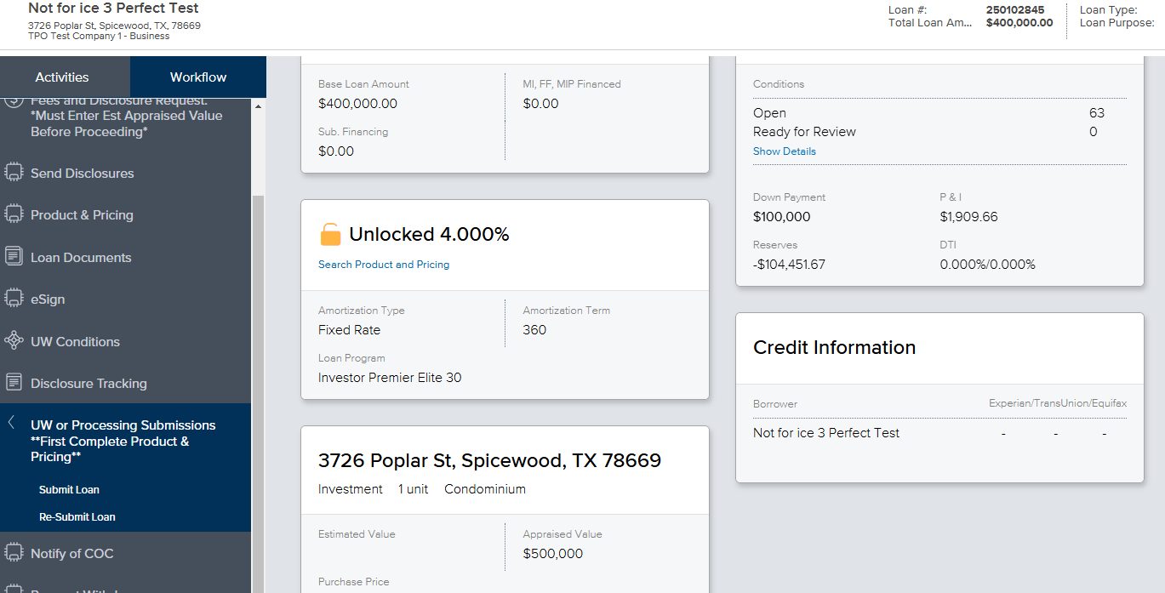
Upload Conditions & Resubmission
Once marking conditions Fulfilled and ready to re-submit to UW
Click on UW or Processing Submissions
  RE-SUBMIT LOAN
Re-Submit LOAN

Slide 30
Services Requested

Slide 31
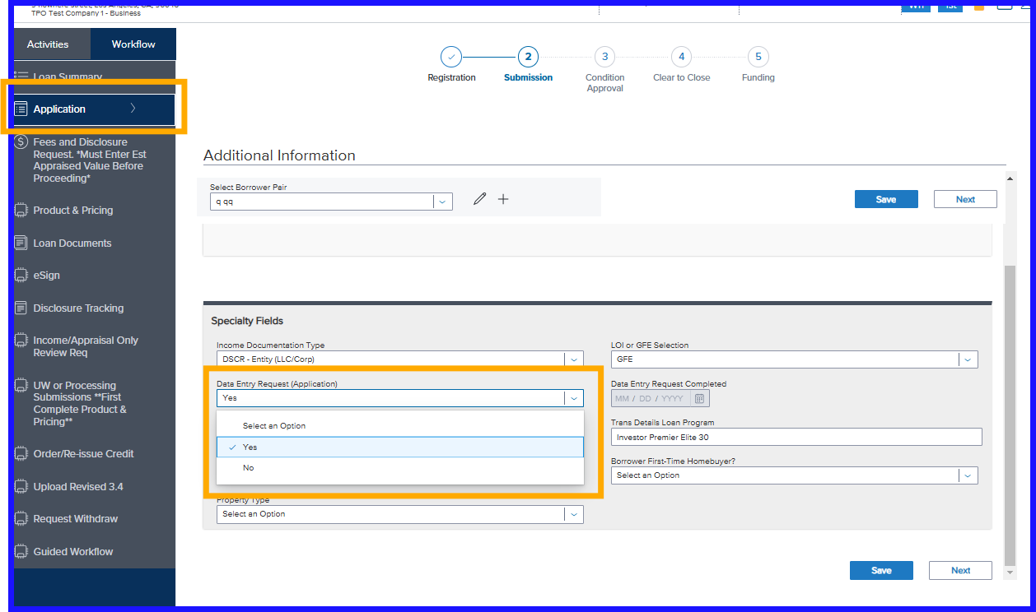
Data Entry
Upload application to "Loan Documents" tab
Go to "Application" then "Additional Information" page
"Data Entry Request" select YES
Click Save
Disclosure Desk receives notification and inputs data points from application to Podium
Notes:
Select Data Entry if you do not have a 3.4 MISMO file, which will route your loan internally for Data Entry of your loan application. If your company is not set up for Da

Slide 32
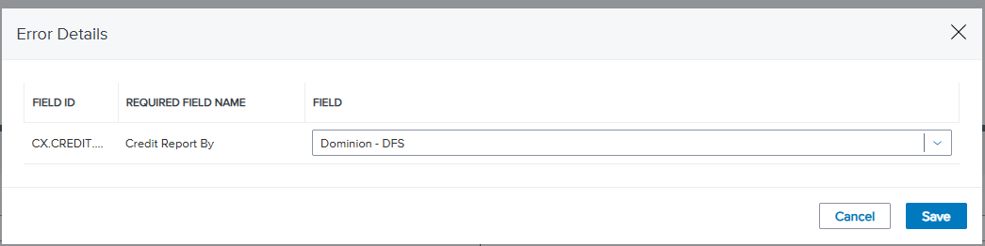
CREDIT – Pulled By Dominion
At Registration, select "Dominion" from the dropdown to pull credit
Notes:
Select Broker – your borrower credit report has been pulled by you under your company name.

Slide 33
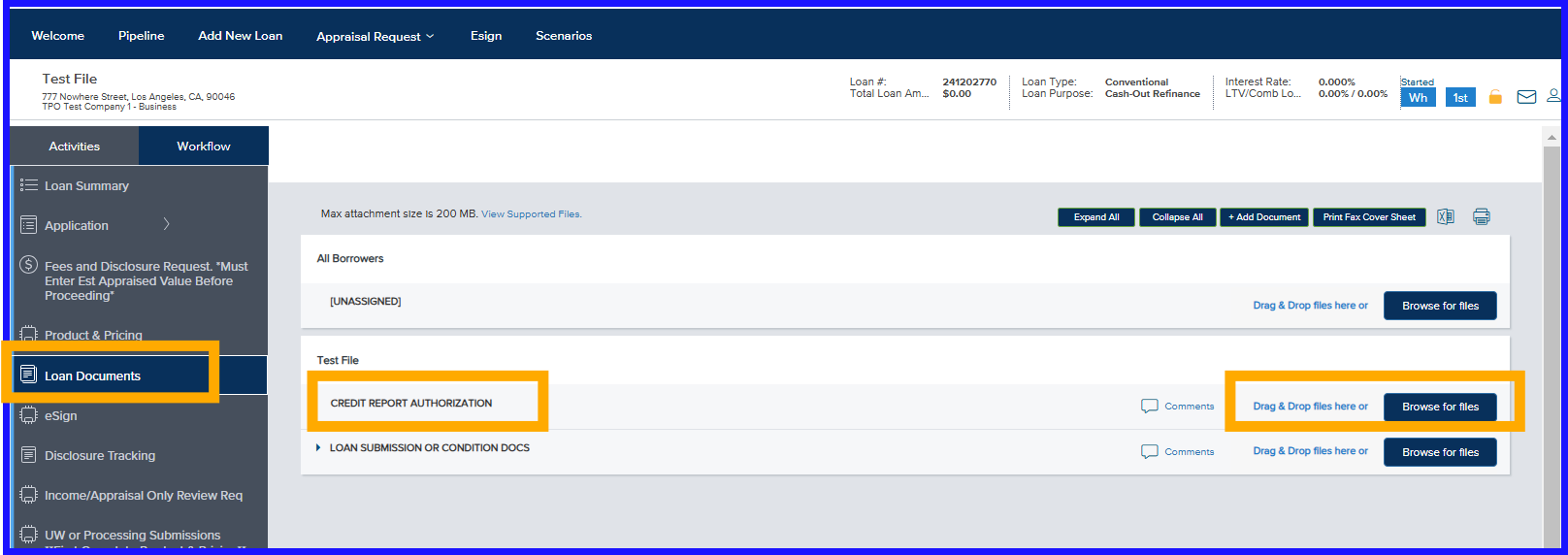
Credit – Pulled by Dominion
Upload "Credit Report Authorization" to "Credit Report Authorization" bucket
Email notification to Disclosure Desk to pull credit
After credit pulled and uploaded to Podium, email notification to Broker
Notes:
For Dominion to pull credit – upload the completed and signed credit authorization to the Credit Report Authorization bucket. Once uploaded and Saved we intake desk will be notified to pull the credit report into the loan file.

Slide 34
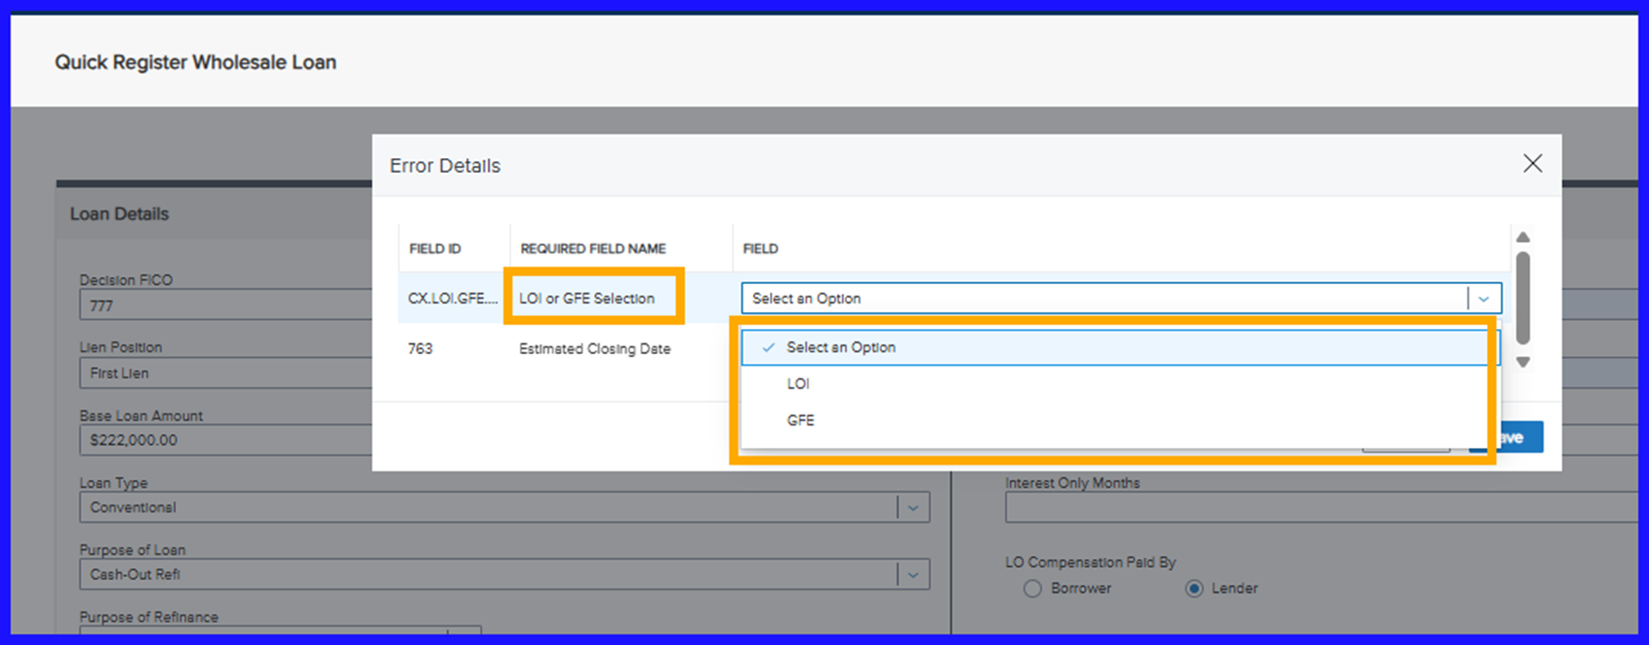
LOI or GFE – Company Profile Set Up for Both
Business Purpose loans only
  Select LOI or GFE
Notes:
If your account is set up for the option for LOI or GFE on business purpose loans, then you will be given the option to select if you want a GFE or an LOI for this loan transaction. If the Estimated Closing Date field is empty, then add it here and then select SAVE.

Slide 35
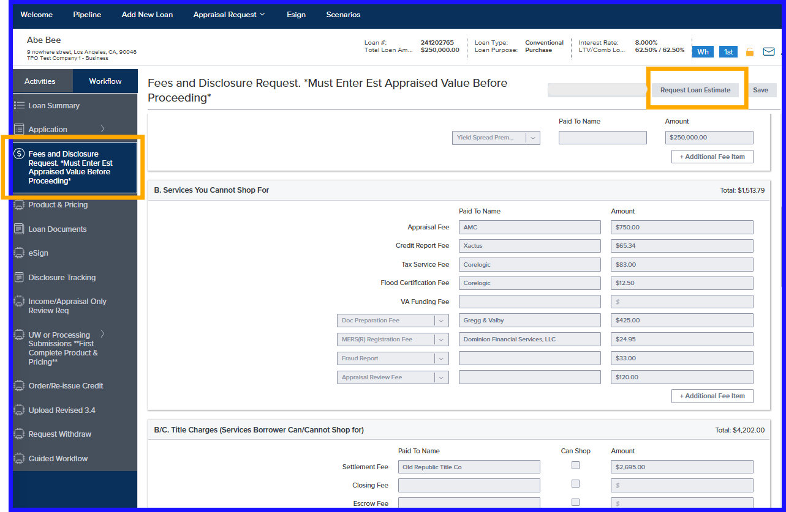
Requesting GFE
Request GFE – Click Request Loan Estimate Tab
Fees will be greyed out once requested
If GFE is not requested before loan submission, disclosure request will be sent simultaneously with the submission
Notes:
If your account is set up for a GFE you have the option to request one her by clicking on the Request Loan Estimate box – the request goes to the disclosure desk and the fees are greyed out on this screen. If you want the GFE to go out with initial loan disclosures you do not have to do anything – do not select Request Loan Estimate – once your loan is moved to Underwriting it will simultaneously go to the disclosure que for initial disclosures to be sent out.

Slide 36
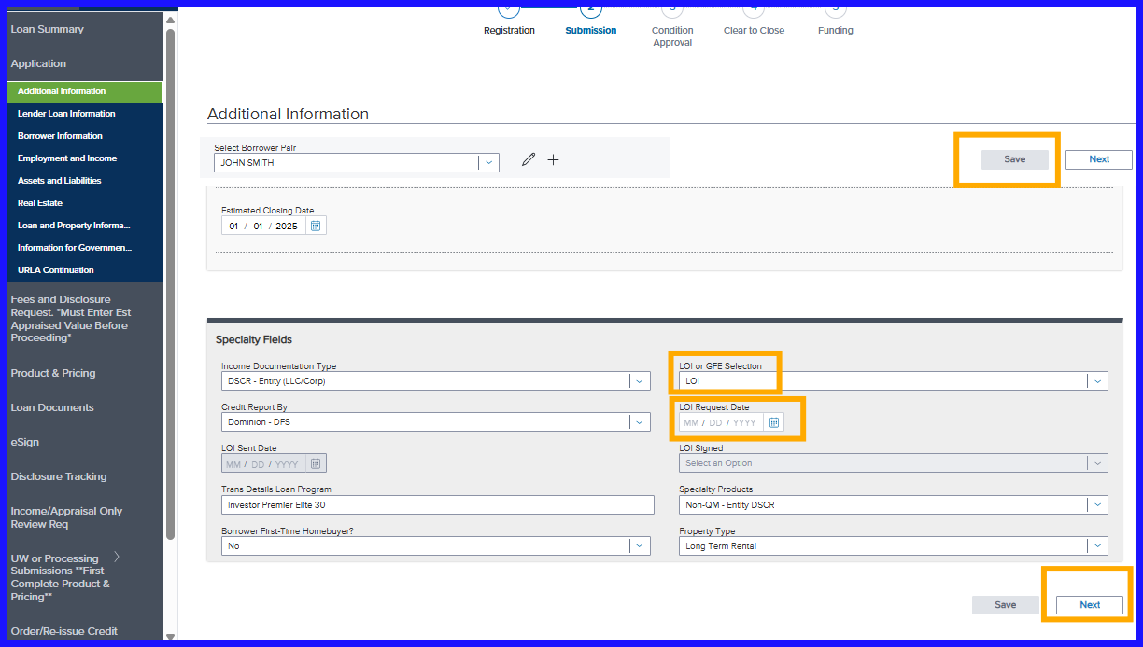
Request LOI – Enter Date
Upload application and credit report to "Loan Documents" tab
Select LOI option
Enter date to request the LOI
Save
Notes:
Select LOI option, and LOI Request Date. Select NEXT

Slide 37
LOI Process
Email notification confirms LOI request received
Disclosure Desk reviews application and credit report
LOI emailed to broker for review
Broker replies to email with any changes needed or sends LOI to borrower for signature

Slide 38
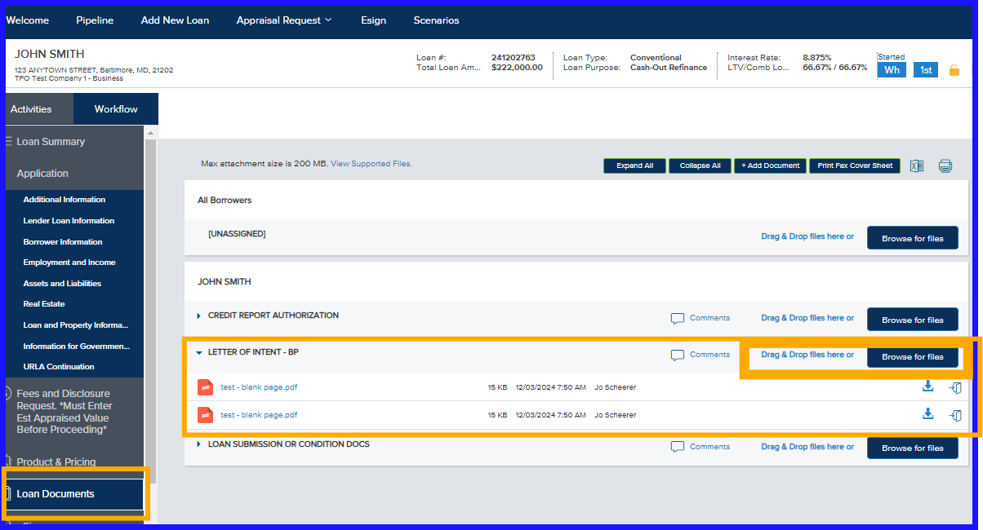
Signed LOI - Upload
Upload borrower signed LOI to "Letter of Intent" bucket
Loans with an LOI cannot be submitted without the signed LOI uploaded
Notes:
Upload the borrower signed LOI into the LETTER OF INTENT bucket. Loans with an LOI can not be submitted without the signed LOI uploaded, and the date the LOI was signed would need to be input

Slide 39
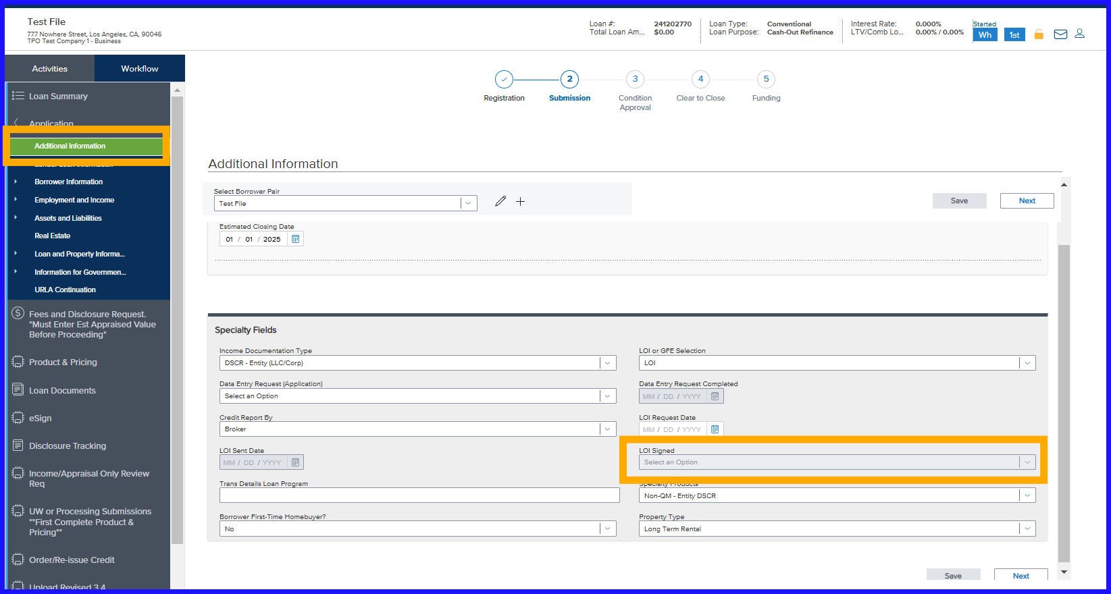
LOI Signed Date – Input for Loan Submission
Pop-up box at "Loan Submission" prompts user to update LOI signed field
Select YES
LOI signed field can also be entered on the Loan Application > Additional Information page if file not ready for submission
Notes:
When you submit the loan, after uploading the signed LOI, you will be prompted in a pop-up box to enter the LOI signed information, and you would select YES in the drop down. This field can also be located on the additional information page, if you want to input that the LOI is signed but are not wanting to submit the loan yet.

Slide 40

Appraisal Order – AMC Links
Notes:
At the top of your page, you will see Appraisal Request. You can select the AMC in the drop down and will be taken to their web site where you can log in with your own AMC credentials. When you place your appraisal order you will select Dominion in the Lender drop down.

Slide 41
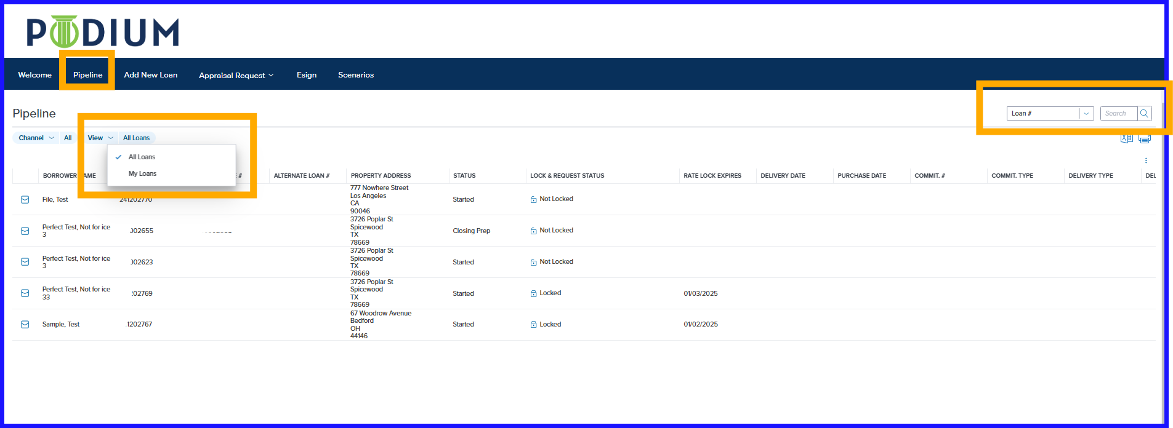
Pipeline Page
Notes:
Your Pipeline Page allows you to sort your loans and also search your loans by loan number and also by borrower name.

Slide 42
Administrator

Slide 43
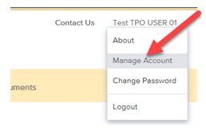
TPO Manager
TPO Manager to log into Podium
On right-hand side of screen in the upper corner, click on username
Dropdown will display
Click Manage Account

Slide 44

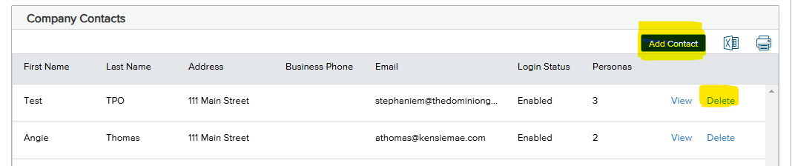
TPO Manager Continued
Click on Company Account
To add a user, click "Add Contact"
  Complete all necessary fields to issue credentials
To delete a user, click "Delete"

